Slide 1
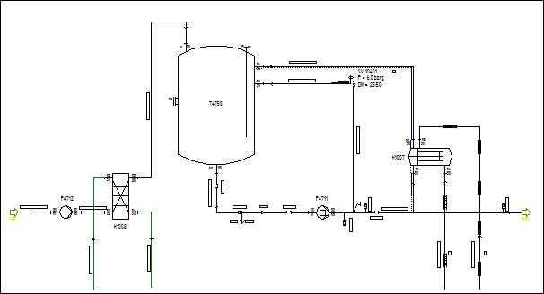
Complete DEXPI Example EP
This is the complete DEXPI Example Equipment and Piping only

